Slide 1



Y3 Information meeting

Slide 2
Welcome to Glebe Junior School
Who’s who
Buildings and layout
Systems and processes
What to expect in Y3 – timetable, curriculum, logistics, enrichment
Inclusion – SEND/Vulnerable groups/Pupil Premium
Welcome pack
Transition

Slide 3

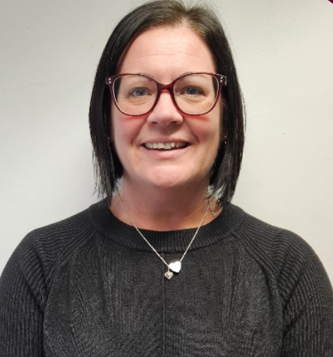
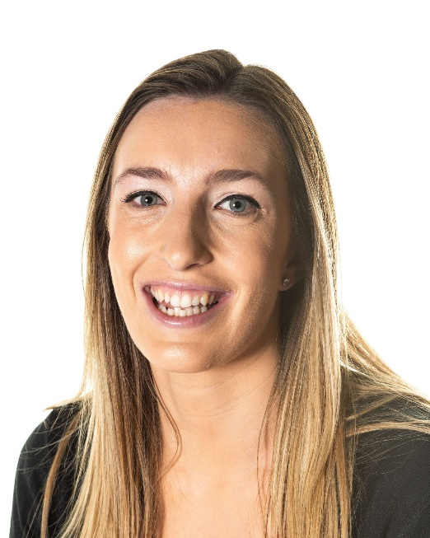
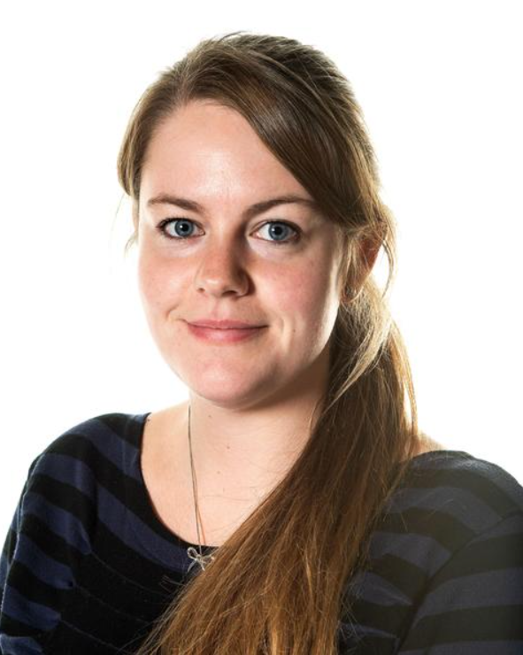
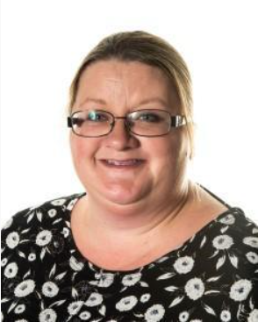
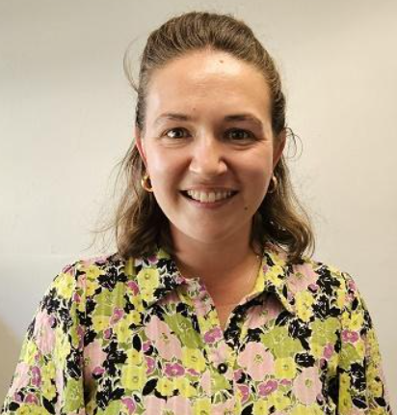
Who’s who?
Ms Williams : Headteacher Miss Titmus: Deputy Headteacher
Miss Stevenson- AHT Mrs Finlayson – AHT Mrs Whelpton – AHT/SENCO

Slide 4
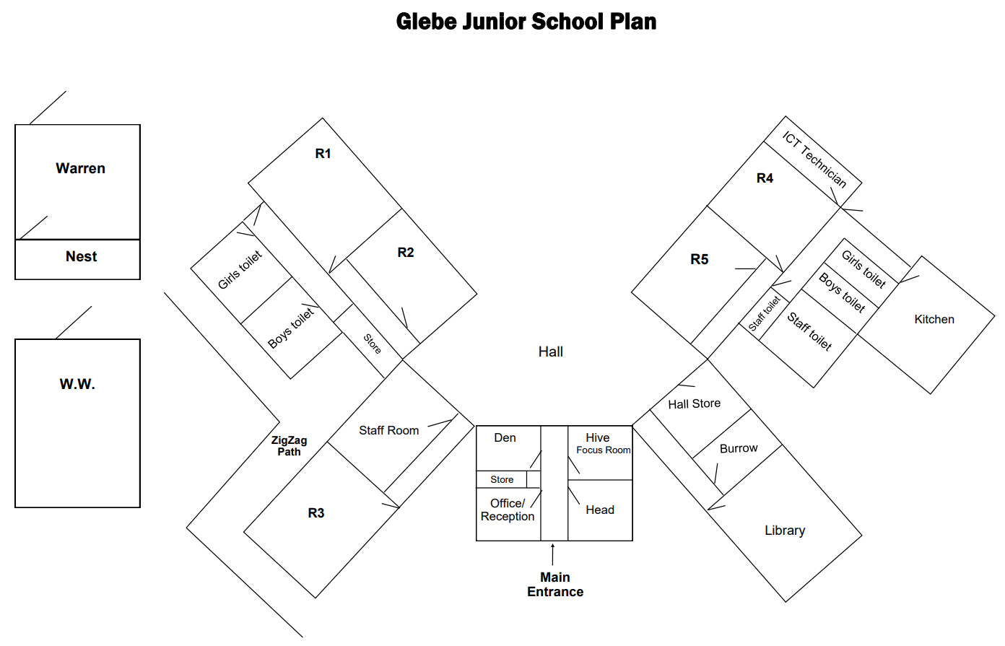
Buildings and layout

Slide 5
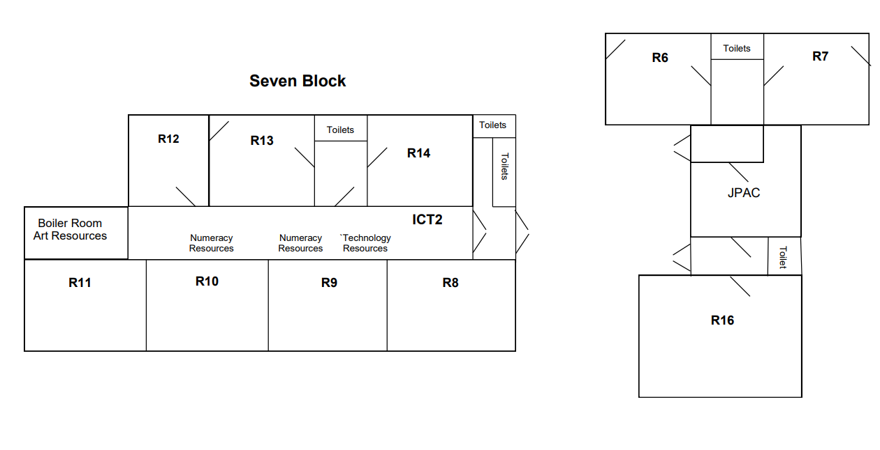
Buildings and layout

Slide 6


Systems and Processes:
Arbor and Class Dojo
We use Arbor as our school information system – an email will be sent to you to enable you to sign up.
We use Class Dojo for school announcements, class information, teacher/parent contact, rewards and photos – a email will be sent to you to enable you to sign up once you have signed up to Arbor.

Slide 7
Systems and Processes: The School Day
Breakfast Club from 7.30am
The school gates will open at 8.45am and children should be in class ready for school to start promptly at 9am.
Break times: 10.30-10.45am Y3 & Y4
Lunch time: 12.00pm - 1.00pm
End of the day: 3.30pm for Y3 & Y4

Slide 8
Wraparound Care
Before school
  Morning Club run by Glebe in our school hall.
  7:30am to 8:40am.
  Breakfast, childcare and activities.
  Booking through Arbor £4
After school
  After-school club run by JPAC at Glebe.
  3:15 to 6pm – see below website for pricings.
  Activities and snack.
  Infants/Nursery children collected from schools.
  INSET day and holiday places available.
www.jpacschoolclubs.co.uk

Slide 9

Systems and Processes: Absence
If your child is unwell or unable to attend school, please call the school office (answer phone 24/7) or message on ARBOR by 8:45 AM.
Attendance Officer will call home if no message is received.
Any issues at all with getting your child to school please speak to us.
Good attendance is celebrated in assembly every week

Slide 10

First Aid and Medication
Bumps and scrapes happen often while children play and explore.
We have a number of first aid trained staff in school.
We will be using ‘Medical Tracker’ to inform you about first aid/ accidents throughout the day. This app emails parents with the basic details.
If the injury is a concern someone will call you to discuss it further.
We can dispense medication in school – it must be prescribed and a permission form completed with each medicine.
Inhalers, epi-pens and other life saving medications are all kept with the children in their classrooms.

Slide 11
G
L
E
B
E
GROW
LEARN
ENJOY
BELIEVE
ENCOURAGE
THE GLEBE WAY

Slide 12
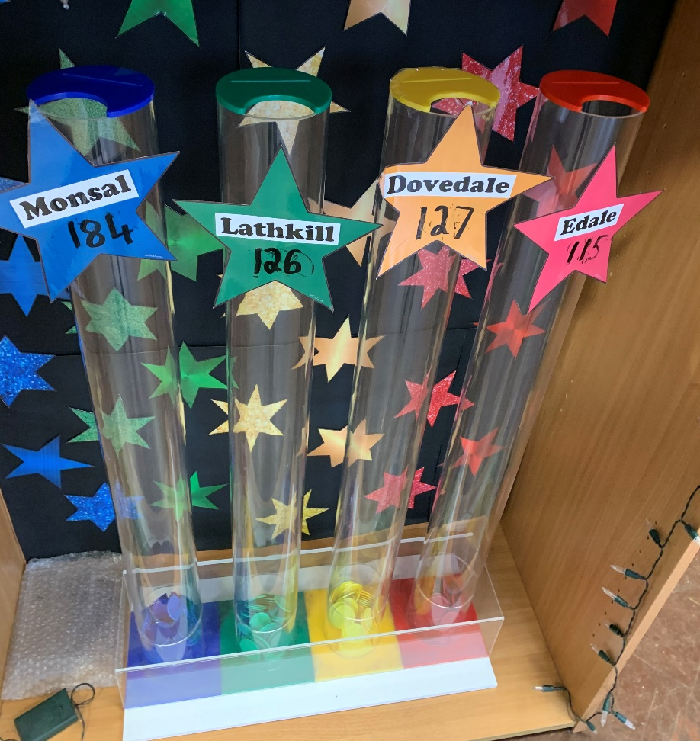
House Tokens
Children are rewarded with tokens for
behaving in the ‘Glebe Way’ which are
collected in house colours.
Tokens are also collected for inter house
competitions, both sporting and
academic.
Siblings will be placed in the same house.

Slide 13
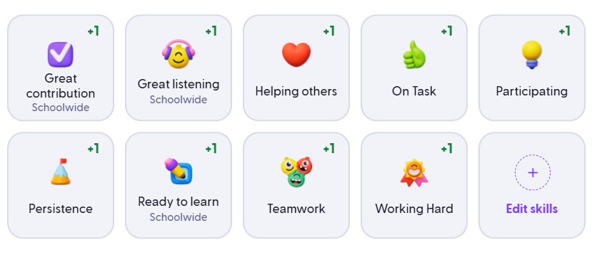
Celebrating success
Dojo Points
Celebration assembly – Star of Week, Glebe Way Award,
Star Readers, Star Writers, Maths Star
Awesome Attendance, Embark Award
Awesome Attendance – Which year/class has the best attendance each
week
Embark Award

Slide 14
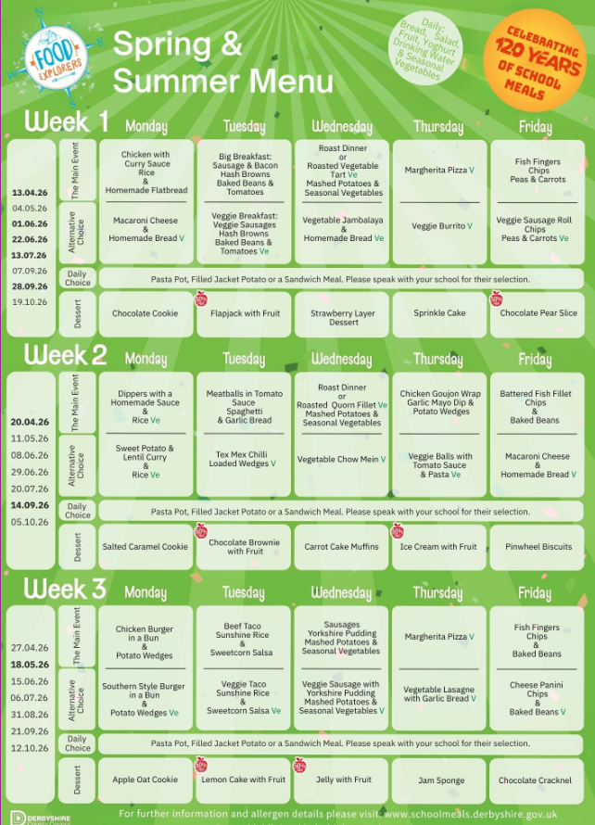


Lunchtimes:
School dinners or packed lunches.
DCC catering – Food Explorers, meals cost £3.25
Kitchen onsite and all meals freshly prepared
Free School Meals – apply online
Free school meals - Derbyshire County Council
Starting our Opal Play journey

Slide 15
What to expect in Y3
Uniform…
White Polo T-Shirt/Shirt
Black/Grey school trousers/shorts
Black/Grey knee length skirt
Burgandy school fleece
Burgandy school jumper/cardigan
Burgandy/red gingham dress
Black shoes/trainers (no logos)
White PE T-Shirt
Black PE shorts/tracksuit bottoms
Indoor/outdoor trainers
Black jumper/hoodie
House competition T-Shirt – red, blue, green, yellow

Slide 16
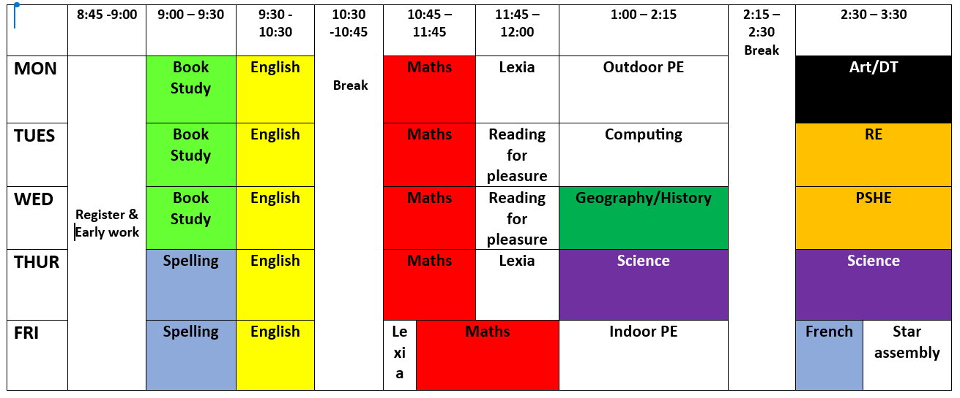
What to expect in Y3
Timetable/What to bring to school….
School diary
PE kit (labelled)
Reading book
Water bottle
Labelled coat

Slide 17
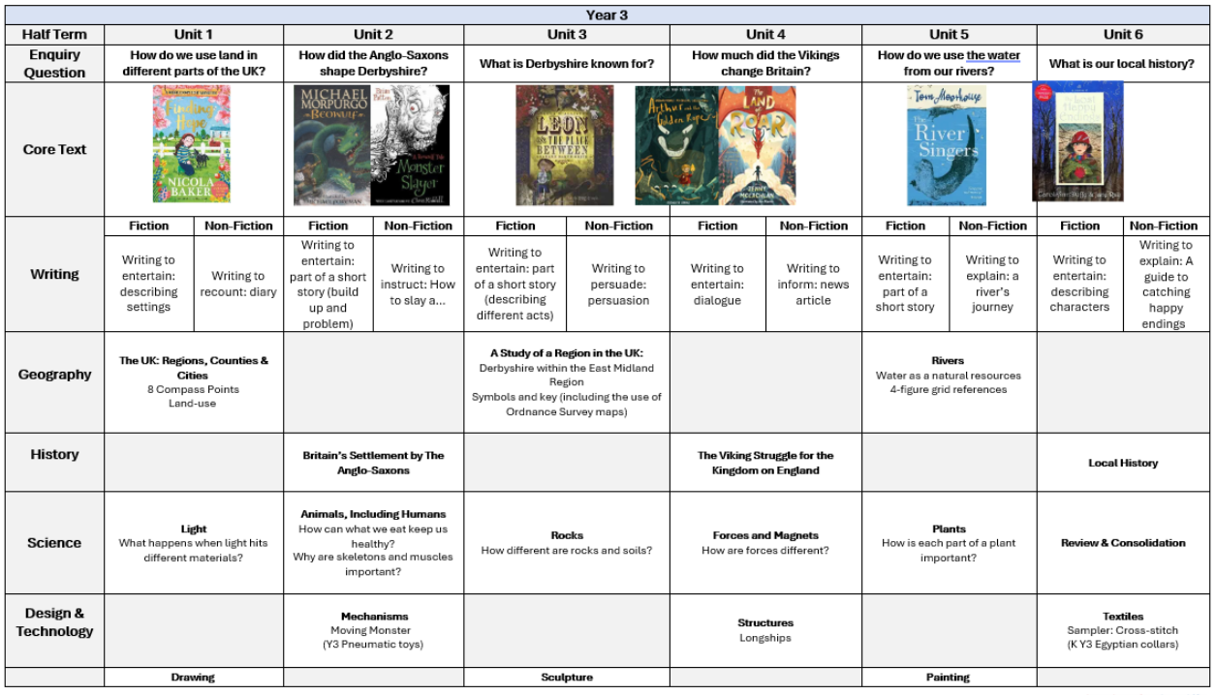
What to expect in Y3: Curriculum

Slide 18




What to expect in Y3: Curriculum

Slide 19
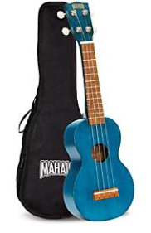





What to expect in Y3: Enrichment
Music
School Trip
Enterprise week
Arts and cultures week
After school clubs

Slide 20
Inclusion – SEND/Vulnerable groups
Quality First Teaching
Adaptive Teaching
Individual Education Plans
Resources
Focused interventions
Pastoral support – ELSA, Positive Play, Lego Therapy, Forest School
External agency support where needed

Slide 21

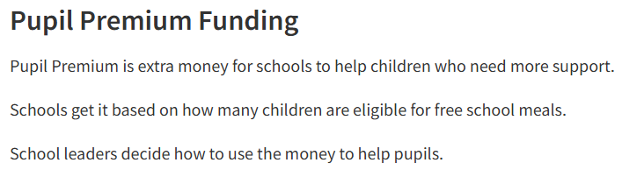
Inclusion -
Pupil Premium

Slide 22
Transition Day
Wednesday 15th July
Arrive at school for 9am - children will go straight through to the hall to meet the teachers.
Children to come in their usual school uniform.
School dinner numbers will have been sent through in advance from Infant schools.
Collect children at 3.30pm from playground

Slide 23
How can you get involved:
Parents invited to Maths Day, World Book Day, Enterprise, Anti-bullying Week, Wider Opps Performances, Assemblies.
Book Fair twice a year
Annual Survey / Questionnaire
Parents welcome to join Governors if availability!
PTA – newly established for 26/27 to support the school in providing further enrichment activities as well as resources that sit outside of school budgets.
School disco’s
Christmas/Summer Fair
Film nights
Easter activities……. Plus other events

Slide 24
Welcome pack…
Admission Form
End of Day arrangements
Breakfast Club registration
Free School Meals application information
Medical diet information
JPAC leaflet
Free School Meal leaflet
Embark Governor Information

